Slide 1

NYU TANDON CAREER HUB · FALL 2026
Data Science Bootcamp
Week 2 · Numpy & Pandas
Instructor: Angelin Ann Jacob
Section 1 · Tue Sept 29
Section 2 · Thu Oct 1
Notes:
Welcome everyone. Today has two halves: first, how the next nine weeks work; then we jump straight into Python using a dataset you all helped create.

Slide 2
Useful Links
Zoom
Brightspace
GitHub
All sessions are virtual. Use ONLY your NYU SSO Login to be considered for attendance
Assignments, submissions and the discussion board, monitored Monday to Thursday.
Slides and Colab notebooks for every session.
Email
1:1 coaching
datasciencebootcamp@nyu.edu for questions, extensions and attendance approvals.
Optional 30-minute technical interview prep. Book it through Handshake.
Data Science Bootcamp · Fall 2026
07
Notes:
Coaching path in Handshake: Undergraduate/Graduate Students, then NYU Tandon Career Hub, then Technical Interview Prep Appointment. Discussion board hours are in the syllabus.

Slide 3
Numpy & Pandas
Get to the libraries used in your day to day tasks as a Data Specialist!
Data Science Bootcamp · Fall 2026
Notes:
Open the Week 1 notebook in Colab and upload responses.csv from the Files panel. We'll run a full, if modest, exploratory data analysis using only the standard language, so nothing happens by magic.

Slide 4
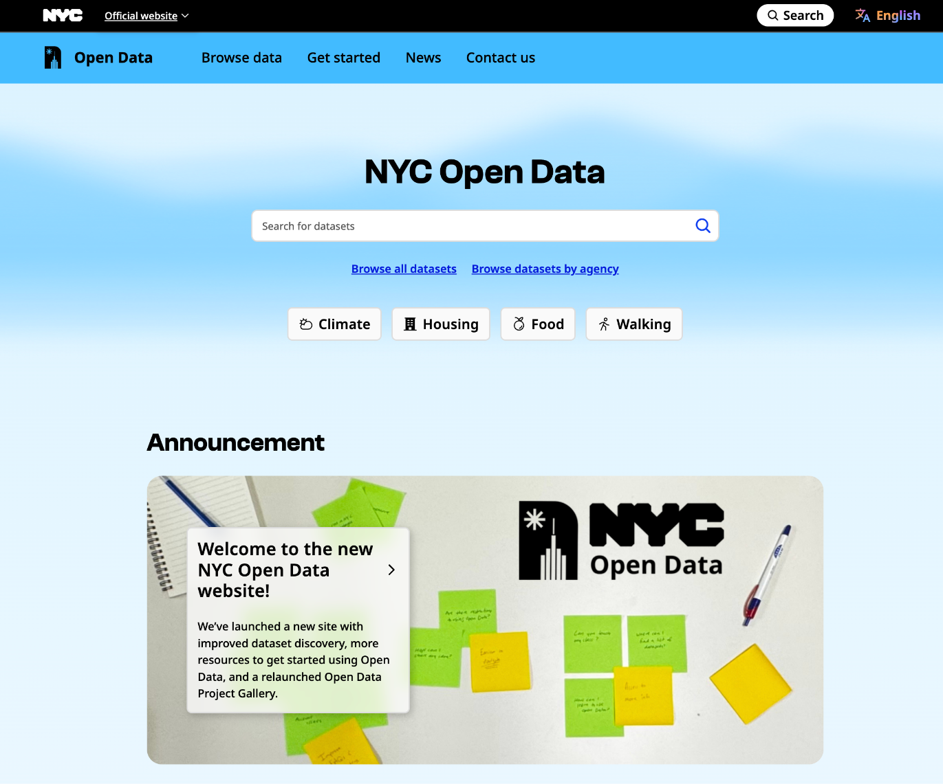
NYC Open Data
https://www.nyc.gov/opendata
Dataset name:
Brooklyn Bridge Automated Pedestrian Counts Demonstration Project (Historic)
Data Provided By:
Department of Transportation (DOT)
Visit: NYC Open Data - City of New York - Brooklyn Bridge Automation
02
Data Science Bootcamp · Fall 2026
Notes:
Same topic both days each week; you must stay in your chosen section. Highlighted rows are the two project presentation weeks. No sessions Thanksgiving week, but the team is available for questions and 1:1 coaching, so use that week for your project.

Slide 5
Before next week
Take-home
Feedback form
Week 3: SQL Fundamentals
The exercises at the end of today's notebook. Submit on Brightspace within one week, by 11:59 PM.
Fill it out after today's session. It counts toward your credential.
Work with Databases and get familiar with SQL Basics!
See you at the social: Mon, Oct 5, 3–5 PM · 2 MetroTech Center, Room 1054
Data Science Bootcamp · Fall 2026
Notes:
Take-home exercises are at the end of the notebook, with an extended challenge for anyone who wants more. Week 2 is Oct 6 for Section 1 and Oct 8 for Section 2.

